Slide 1
Logical Design: Relational model

Slide 2
Introduction to Relational database
Files will be replaced with tables
Variables will be replaced with attributes
There will be records in the tables.
Tables will be related to another table(s).
There will be no duplicate records.

Slide 3
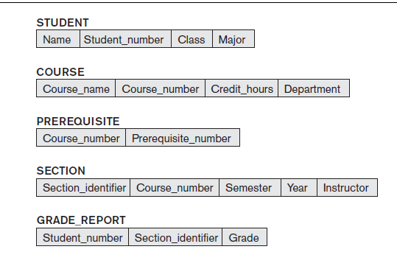
Relational Database schema

Slide 4
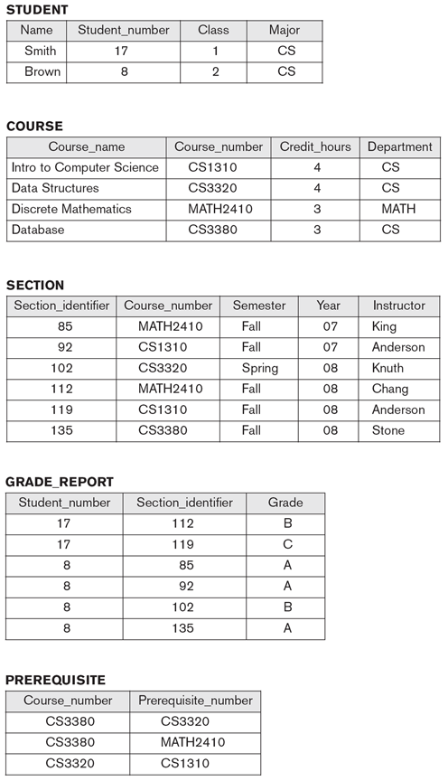
Relational Database state

Slide 5
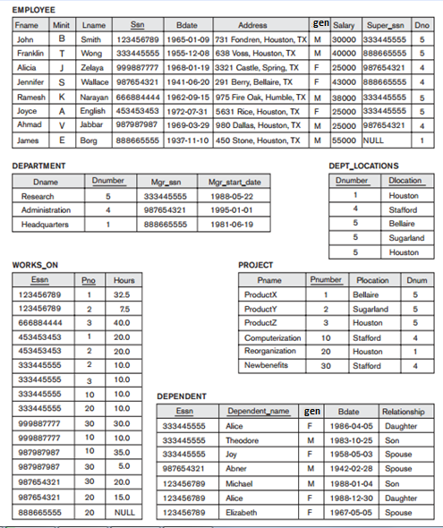
Relational model
A model in which data is maintained in table which is also known as relation.
Relation: A table with columns and rows.
Informal | Formal
Table | Relation
Columns / fields | Attributes
Rows | Tuples (1 record)
# of rows in a table | Cardinality of a relation
# of columns in a table | Degree of a relation
All possible values for a field | Domain of the attribute.

Slide 6
Properties of Relation
Relation(table) must have a name. Relation Name must be unique from all the names in relational schema.
Each cell contain exactly one value.
In a relation, each Column name must be unique.
No duplicate tuples(two rows cannot have the same date ) are allowed in a relation.
Order does not matter in rows/ columns.

Slide 7
Foreign key
Student
Course
Instructor
ID | Name | Crdthrs
ID | Name | Address
ID | Name | Address
Grade
Sid | Cid | Iid | Grade
It is used to represent relationship between two tables.
Primary key of one table becomes Foreign key of some other table.
Foreign key can have duplicate or Null value.
Foreign key must not have wrong value.
It can have a same or different name as compared to that in parent table.
The datatype must be same as that is in parent table.

Slide 8
Database Constraints

Slide 9
Database Constraint
Every relation has some condition that must hold for it to be a valid relation. These conditions are called relational integrity constraints.

Slide 10
1. Domain Constraint
It states that any value that is inserted/updated for an attribute should belong to the data type that has been defined for the attribute.
Example an attribute with integer data type should not be given a string as an input.

Slide 11
2. Key Constraint
There is a property of relational databases that there should be no duplicate rows.
For this we have to consider one attribute that will never be same for two persons/things. (that attribute is primary key that is unique for each row/entry into row)
Example : student, Book.
The unique attribute is called primary key.
It is underlined in the schema/state.
Key constraint states that there should be no duplicate value for the primary key.

Slide 12
3. Entity Integrity Constraint
Entity Integrity constraint states that there should not be NULL value for the primary key.

Slide 13
4. Null Constraint
We can design some attributes in a way that they cannot have a NULL value ever.
Examples ?
This constraint says that an attribute declared as NOT NULL cannot be given a NULL value.

Slide 14
5. Referential Integrity Constraint
This constraint says that the foreign key value should exist in the parent table or the value can be NULL.
Properties of Foreign key:
An attribute is considered as a foreign key if it is a primary key in the parent table.
A foreign key must have the same data type as the data type of the primary key in the parent table.
A foreign key can have a different name from that of primary key in the parent table.
Wrong value -> cannot be
Can be null or duplicate
Datatype-> must be same
Name -> can be same or different

Slide 15
Database Constraint
Key constraint : No duplicate primary key
Entity integrity Constraint: No Null primary key
Domain constraint : Every value / attribute is bound to have specific range of value.
Null Constraint: Every required field is bound to have a value.
Referential integrity Constraint : foreign key value must exist in the primary key of the parent table.

Slide 16
Identify violations

Slide 17
Identify violations
Database Constraints
For the database state(current jou value database k andar pari hoi hain is halat mae it is called database state , agar kuch update kr dein ge then that would be database state ) and schema given to you please specify whether the following operations will be accepted or rejected. If they are rejected which constraint is being violated in that case.
Insert <‘Cecilia’, ‘F’, ‘Kolonsky’, NULL, ‘1960-04-05’, ‘6357 Windy Lane, Katy, TX’, F, 28000, NULL, 4> into EMPLOYEE.
ENTITY INTEGRITY CONSTRAINT(PRIMARY KEY CANNOT BE NULL VALUE )
Insert <‘Alicia’, ‘J’, ‘Zelaya’, ‘999887777’, ‘1960-04-05’, ‘6357 Windy Lane, Katy, TX’, F, 28000, ‘987654321’, 4> into EMPLOYEE.
KEY CONSTRAINT( TWO PRIMARY KEYS CANNOT BE SAME)
Insert <‘Cecilia’, ‘F’, ‘Kolonsky’, ‘677678989’, ‘1960-04-05’, ‘6357 Windswept, Katy’, TX’, F, 28000, ‘987654321’, 7> into EMPLOYEE.
REFERENTIAL INTEGRITY CONSTRAINT( foreign key cannot be a wrong value.

Slide 18
Identify violations
Insert <‘Cecilia’, ‘F’, ‘Kolonsky’, ‘677678989’, ‘1960-04-05’, ‘6357 Windy Lane, Katy, TX’, F, 28000, NULL, 4> into EMPLOYEE.
Good to go.. ;) , this query will work I see no problems in it.
Delete the WORKS_ON tuple with Essn = ‘999887777’ and Pno = 10.
(no idea what will this do , ask a friend tomorrow ).
Delete the EMPLOYEE tuple with Ssn = ‘999887777’.
(still no idea whether this will be valid or not )

Slide 19
Identify violations
Delete the EMPLOYEE tuple with Ssn = ‘333445555’.
Update the Dno of the EMPLOYEE tuple with Ssn = ‘999887777’ to 1.
Update the Dno of the EMPLOYEE tuple with Ssn = ‘999887777’ to 7.
Update the Ssn of the EMPLOYEE tuple with Ssn = ‘999887777’ to ‘987654321’.

Slide 20
Referential integrity constraint
Student (Base/ Reference table)
Grade (Referencing table )
Sid | Name | Address
Cid | Sid | Grade
Insert
Delete
Update

Slide 21
Solution of Foreign key violation
DELETE
On delete / Update Cascade
Automatically delete / update data
On delete / update Set NULL / Default
Automatically set Null.
On delete no action is performed by default , but the problem is jb main table where it is referencing the foreign key from agar udhr koi change aye ga and the change is not represented here then we would get foreign key violation and in order to combat that problem we use the on delete/on update so that the foreign key is dealt with automatically when something goes down with the primary key that it is referencing tooo ☺

Slide 22
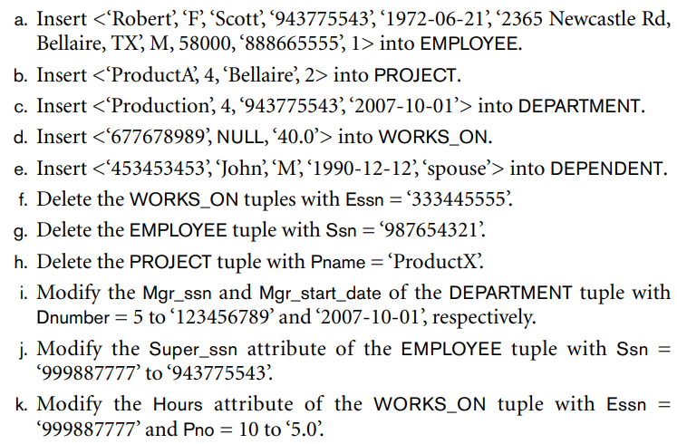
Class Activity: Identify violations
Domain Constraint
Key Constraint
Entity Integrity Constraint
Referential Integrity Constraint.
1.M(domain constraint) ‘m’
2. Referential integrity constraint
3.Key constraint(duplication of primary key)
4. Referential integrity constraint + entity integrity constraint
5. Okay
f.

